Slide 1
EPAM Pega BRE Response
Prepared for ADNOC
August 2020

Slide 2




Pega Competency
Best in class
consulting
team
Key facts
Training
Academies
Certified
specialists
10+
2017
Years of BPM Delivery experience
Strategic alliance established
50+
5+
Global
Presence
PEGA
PRACTICE
Governance
Global Certified Consultants
Global Services Locations
Strategic BPM platforms: Pega, Appian, Elma, Camunda, OpenText
Certified Delivery Partner
80% of BPM engineers are lead and senior architects certified
Education Programs synched-up with training academies
Adoption of BPM delivery methodology
Organic growth in new locations
RPA
Expertise
Accelerators
Industry
Expertise
Solutions
Support
Notes:
So talking about our BPM practice, we formally become a separate team in 2017 and have established strategic partner relationships with Pega, Appian, and Camunda. Having said it, we are accounting for more than 10 years of BPM delivery experience. Globally, we are a team of 50+ certified BPM engineers and architects primarily based in Central Europe. Our team consists of lead and senior software engineers and solution architects who gained skills, product certifications and experience in multiple BPM platforms and Intelligent Automation technologies.
On top of it, as we talk about our key differentiators, we have strong experience in RPA technologies, DevOps and Test Automation.

Slide 3












Helping our Key Clients to solve BPM Challenges
COMPANY | PROJECT DESCRIPTIONS | SOLUTION | RESULTS
 | Case management solution migrating Order Delays and Delivery Blocks processes from RPA to BPM platform |  | Implementation of E2E customer journey, with built in service levels, correspondence and reporting capabilities, Integration solutions with SAP backend and external database 6 FTE reductions as result of process automation
 | Multiple BPM and RPA initiatives across different divisions and regions |  | 70% reduce the manual workload to process new product item 25% decreased Time-to-market of launching new product through intelligent processing Secured process of data creation due to RPA engine
 | Development and Upgrade of Appian-based Workflows |  | Improvement in service excellence resulting in 20% increase in customer retention. Lower costs through streamlined operations Real time metrics on the process lifecycle
 | Transformation of Consumer Obligations Fulfillment Platform with Alfresco Process Services |  | Reduction of operational and support costs Enabled business process flexibility Solution could be used to accelerate upcoming Alfresco Process Services projects
 | Implementation of a new sales system across multiple banking areas to better match banking products with clients. |  | Integration solution between WebLogic Portal and PEGA Integration solution to update CIBC customer master data UI level integration with the PEGA application allowing users to switch from the PEGA UI to the enterprise customer information system UI screens
 | Time Tracking application with Management Portal to collect real time metrics on process lifecycle |  | Model -riven process with defined roles, security model, service levels Management portal integrated with document repository system.
 | Client Service Events Management system. |  | 40% development time saving over previous solution Multi-dimensional automation: Client Advisors can concentrate on decision making instead of routine tasks 60% increase in maintainability stemming from a unified platform allowing to quickly create new Pending Items
Notes:
Here’s a snapshot on our clients and BPM implementations. As a most recent one, EPAM is implementing a Pega platform in Proctor & Gamble company in a supply chain area. More details to follow in one of the case studies below.

Slide 4














Partnerships and Solutions
Notes:
As already said we are a certified partner for some leading BPM and RPA product and technology companies including Pega, Appian, Elma, Worfusion and many more.

Slide 5
BPM Delivery Centers & Headcount
BY
RU
PL
UA
SL
US
IN
50+
Global Certified Consultants
Notes:
Location-wise we’re primarily growing our strategic locations in EMEA region and India. Our current team is accounting for 50+ solution architects and software engineers and we have an ambitious plan to double our team by year-end.

Slide 6
Case studies

Slide 7

BPM Solution for Order Management – Order Delay
Key Highlights
EPAM is implementing a Pega-based solution delivering the following functionality:
Business Transformation via Case Lifecycle
Integration Elements:
  SAP BAPI Integration
  WorkFusion Integration
  CCL
Improved Operational and MI Reporting for facilitating business process governance
One Screen Solution – Significant decrease on order delay processing time
CLIENT DESCRIPTION:
Due to operational reasons, P&G is forced to delay some of the orders and later reflect it in their core systems. Today this is done in a manual manner therefore increasing human error and inappropriate decisions. P&G requires a better way to integrate Order Delay related data in one place, to facilitate decision-making process.
WHY THEY NEEDED US?
EPAM has proven successful delivery for multiple automation projects for P&G globally. After gaining P&G trust, EPAM is being considered a strategic partner for business project management projects as well.
Results FORECASTs
Increased Operational efficiency
  FTE reduction due to minimized complexity and time spend on processing delivery blocks
  Improved end user experience
  Orchestration of overall Order Delay business process management: DACH and NE
Notes:
In early 2020 P&G has engaged EPAM as a strategic vendor to implement several business processes in Order to Cash area using Pega platform. This is an ongoing programme which will span over to 2021. as part of this work, our team has delivered several business applications including order delays which is dealing with delayed orders. Processing delayed orders is a manual process which requires multiple look-ups in external systems and manual updates of product and customer master data in the systems of record. Our team has implemented a case orchestration solution invoking both BPM and RPA capabilities by integrating with Workfusion platform and configuring bots to automatically update order details. This work results in increased operational efficiency (reduced processing time) improved user experience and, reduction of manual effort.

Slide 8
END-TO-END DELIVERY METHODOLOGY

Slide 9
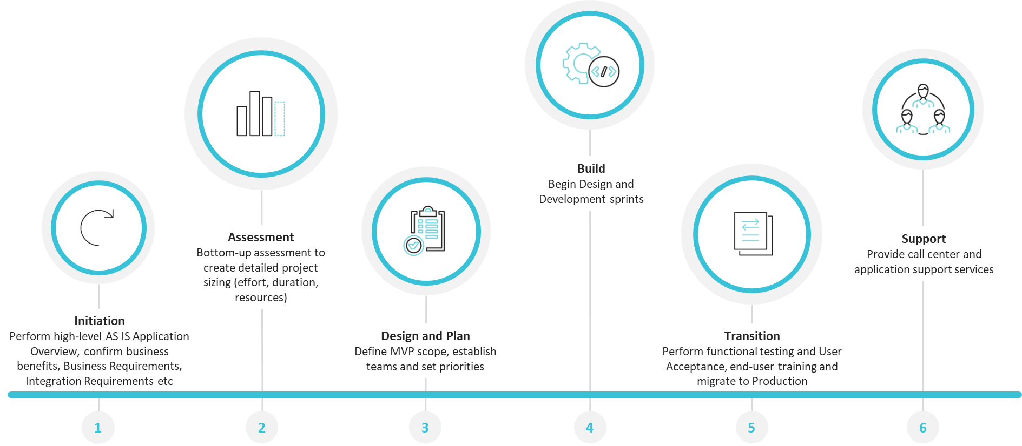
End-to-End EPAM BPM Delivery Methodology
Initiation and Assessment
Execution
Notes:
This is our corporate E2E BPM Delivery Methodology which is broadly split to Initiation and Assessment and Execution stages. During our Project initiation our team is completing assessment of business processes, documenting business benefits, business requirements and functional specifications, Integration requirements and data points. During this stage we produce such deliverables like Technical Solution Design Document, Integration Specifications, Test Strategy and implement PoC as needed. Execution stage is focused on delivery where we’re going through Design, Build and Transition phases. At completion of the Delivery stage and depending on Project SoW, we are also providing production support to our client’s applications.

Slide 10
Zoom in EPAM BPM Delivery Methodology
1 WEEK
2 WEEKS
INITIATION
ASSESSMENT
KEY INPUTS
KEY DELIVERABLES
ROLES
CLIENT
EPAM

Slide 11
Zoom in EPAM BPM Delivery Methodology (Execution Stage)
5-8 WEEKS
3-WEEK ITERATIONS
3-5 WEEKS
DESIGN
BUILD
TRANSITION
KEY INPUTS | Confirm MVP and Create Project backlog Prioritise functional specs and project deliverables Project Sizing, PoC Dev/QA environments System Access granted | SDD (Epic Level) provided SDD (TO BE) signed off by PO and EA Team (incl. SME) onboarded + KT Stage Environment | Dev sprint completed (DoD) Sprint testing signed off by PO Pre-Prod/Prod Environments UAT (SMEs) Onboarded
KEY DELIVERABLES | Set-up project team, standards, governance Create Detailed Solution Design Document, including integration solutions, data sources and systems, channels, UI. Create Data Model and Entity Model Create Logical Architecture Diagram Confirm Build Estimates, Cost & Timelines, Team structure defined | Agile cycles and backlog plans Implement dev sprints Low-level design, build and test business processes, UI, Integration solutions, MI reports and correspondence, other product components, business rules and custom-build logic. Product Demos | Perform testing (functional, UAT, Performance, PEN/Security) End-user training completed Application Hardening Production release candidate Go/No Go
ROLES
CLIENT | PO, SME, EA, App Architect | PO, SME, EA, App Architect | PO, SME, UAT, App Architect, Trainer
EPAM | DM, ApprWorks Platform Architect, Business Analyst, SA, QA, SC | DM, AppWorks Platform Architect, Sr Developers, Business Analyst, SysAdmin, SA, QA, SC | DM, AppWorks Sr Developer, Business Analyst, QA
Notes:
So looking in more details at the Execution Stage we have some specific pre-requisites required in Design, Build and Transition.
If we speak about Design – we need to ensure PDD is signed off, project sizing, PoC are completed. Dev/QA environments are provisioned and system access is granted.
As we move into Design activities, some of our key deliverables are onboarded project team, SDD, Solution design, application Architecture, Build estimates etc
Build
Transiiton

Slide 12
High Level Project Scope

Slide 13

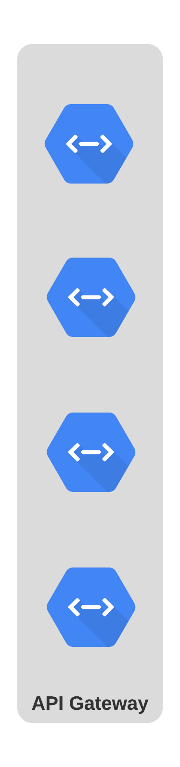
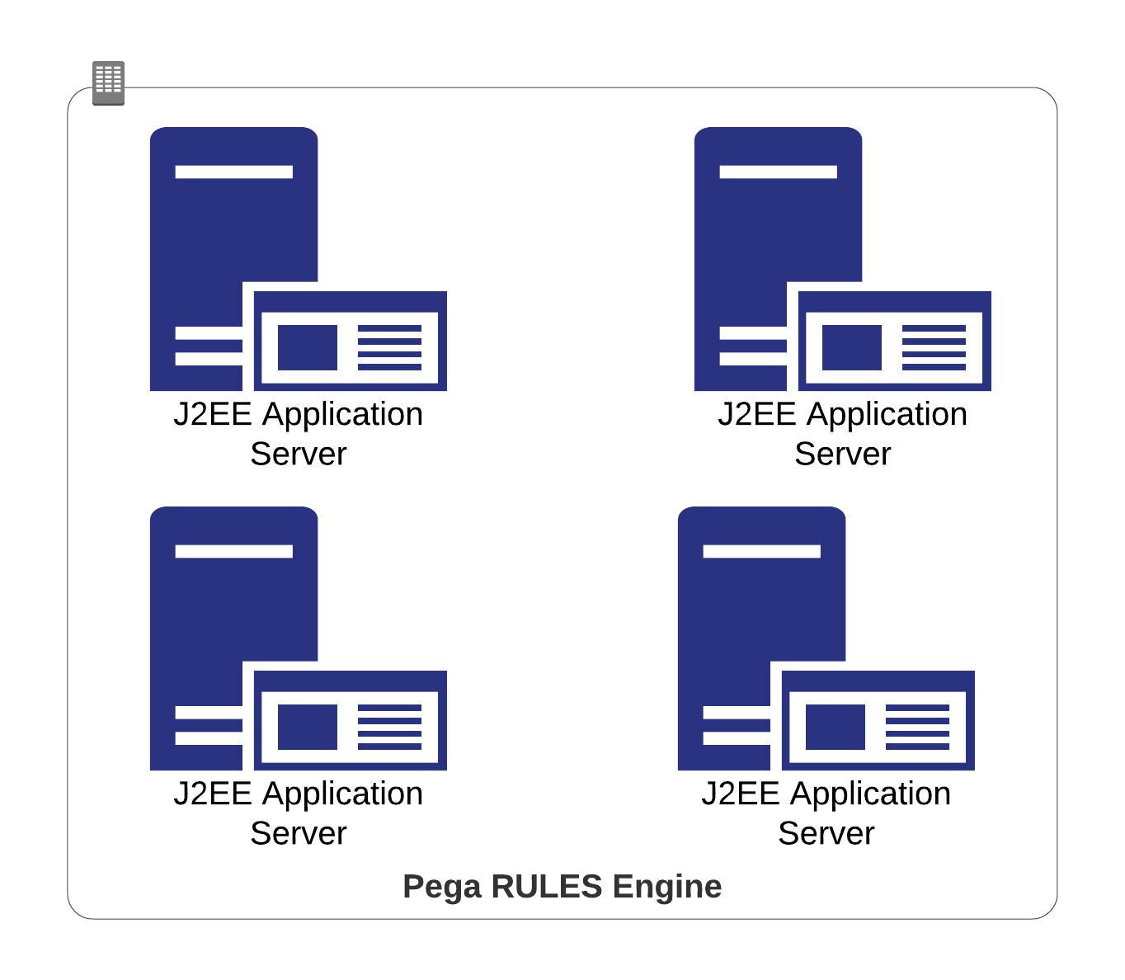

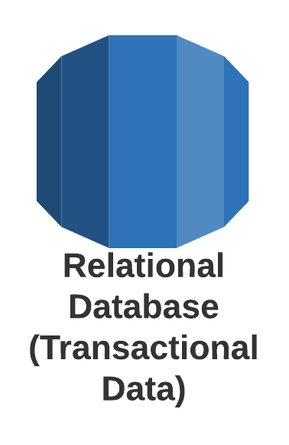
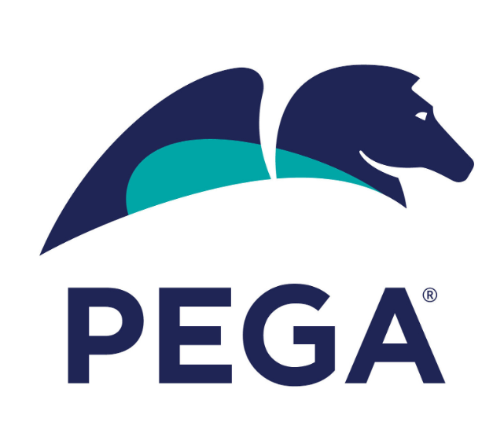
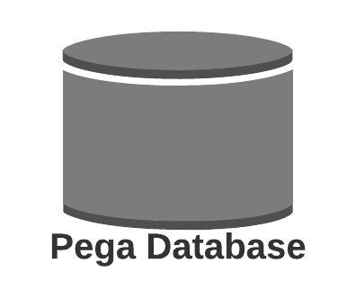
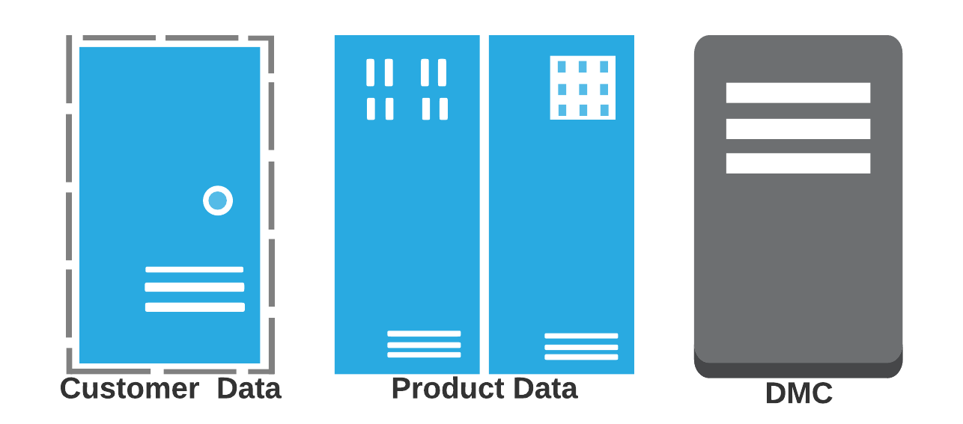
High Level Solution Design – Option1 (Pega Headless Implementation)

Slide 14
Project Team Structure
ADNOC
Delivery
Manager
Programme/Project Manager
EPAM
Engagement Lead
Project Manager
Product Owner
Part-Time Roles
Trainer
.Net Solution Architect
Pega Lead System Architect
Enterprise Architect
Subject Matter Experts
IT Technical teams
.Net Developers
Pega Senior System Architect(S)
Pega Business Analyst(s)
Pega System Architect(s)
QA Engineer

Slide 15
High Level Project Plan

Slide 16
Project Costs
Pega Platform configuration (application foundation, data model, data migration etc)
Pega Application Configuration
Build API services (new)
Rebuild existing API services (reuse)

Slide 17
Assumptions
If we implement a full Pega platform implementation project we will reduce significant work effort related to configuring API services between e-WDP and a BPM back-end
Pega BRE implementation is more complicated comparing to a greenfield Pega implementation including FE and BE implementation

Slide 18
Thank you

